Slide 1
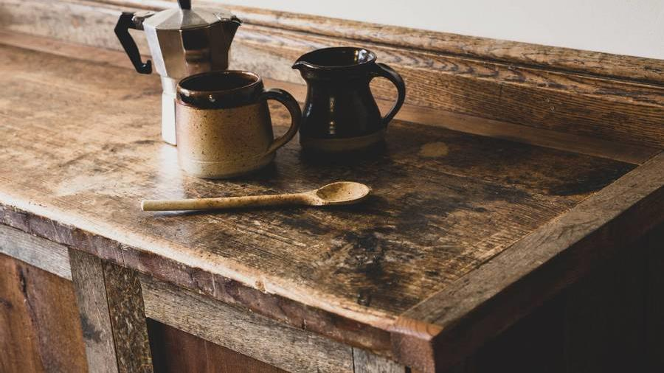
COFFEE SHOP SALES ANALYSIS
Bright light Coffee Shop

Slide 2
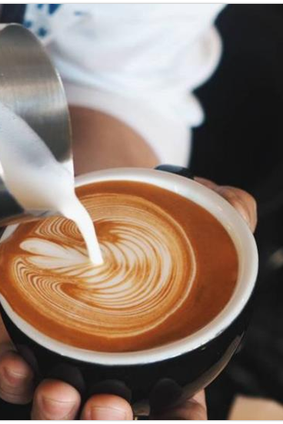
Introduction
Welcome to our coffee shop
analysis , where we explore the
science behind our thriving cafe.
From market trends and
Customer preference to branding
strategies. We delve into what makes
the coffee shop successful.

Slide 3
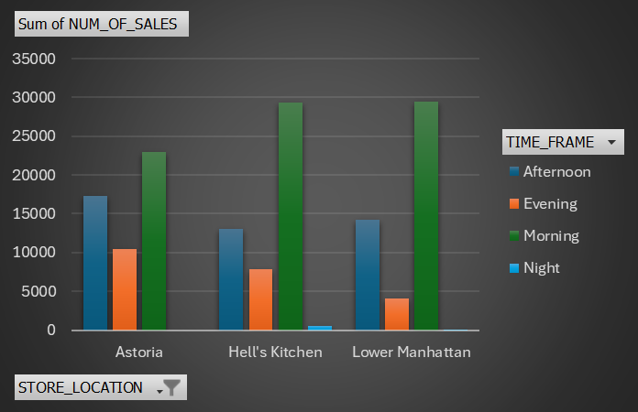
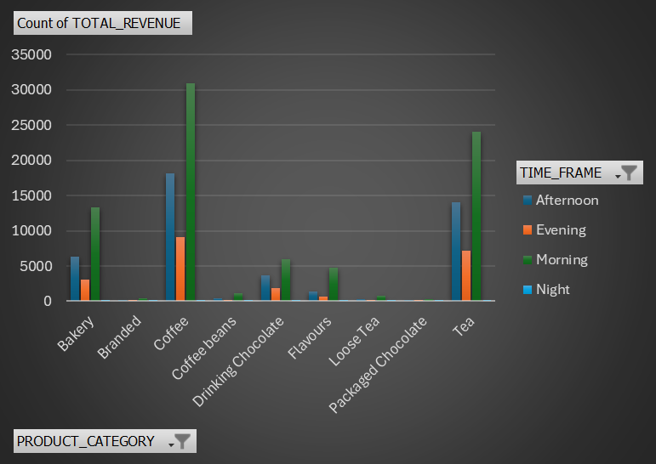
Number of sales by store location per timeframe
Number of sales by product category per timeframe
Insight:
Lower Manhattan and Hell’s Kitchen contributes the sale in the morning with 19,75% and 19,69%
While Astoria has highest sales at afternoon and evening with 11,56% and 6,99%
And at night the store locations seem to have low sales.
Insight:
Morning sales for coffee and tea contribute the highest sales at 20,75% and 16,12%
While branded, coffee beans, loose tea and packaged chocolate contribute the lowest sales.

Slide 4
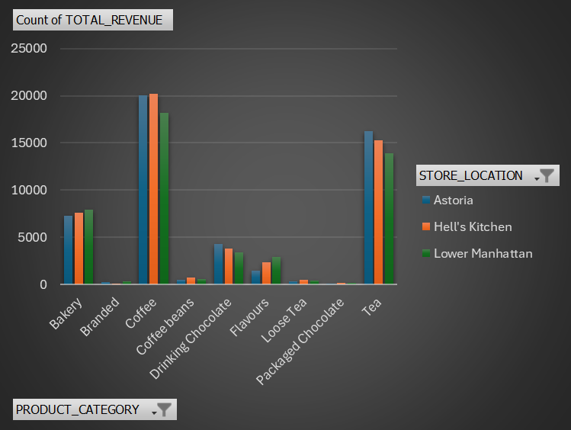
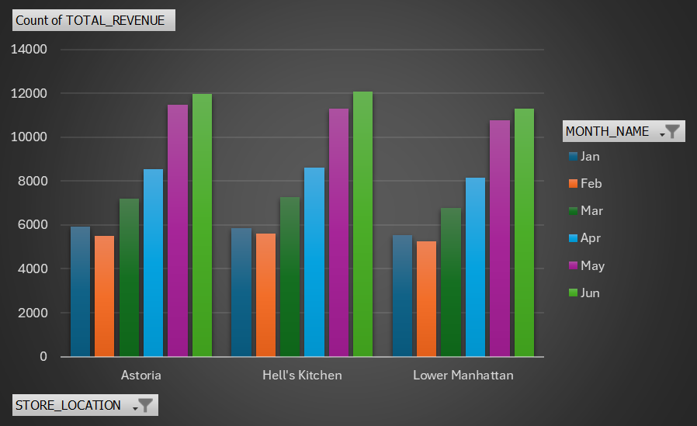
Product category sales per store location
Number of sales per month by store location
Insight:
Coffee sales at hell’s kitchen are at 39,79% while tea at astoria is at 32,14%
Lower Manhattan has the highest sales of bakery and flavours with 16,51% and 6,13%
Insight:
Hell’s kitchen has the highest total number sale with 34,02%
While Astoria has 33,93%
And Lower Manhattan with the lowest with 32,04%

Slide 5
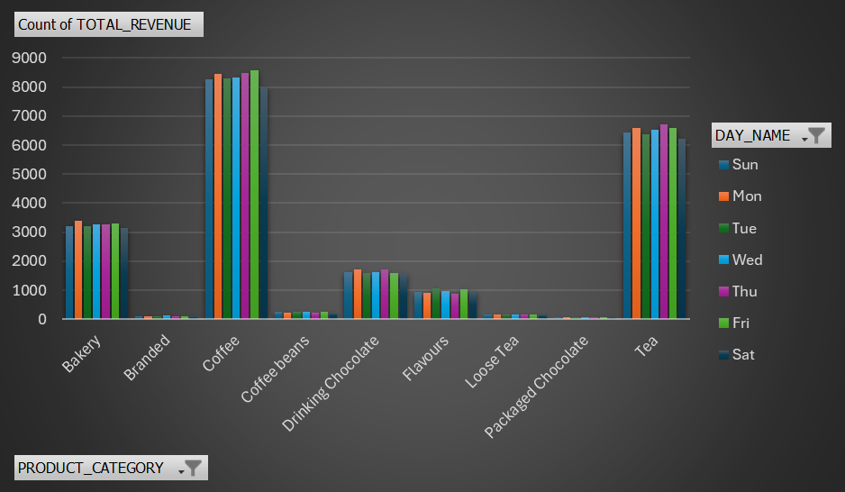
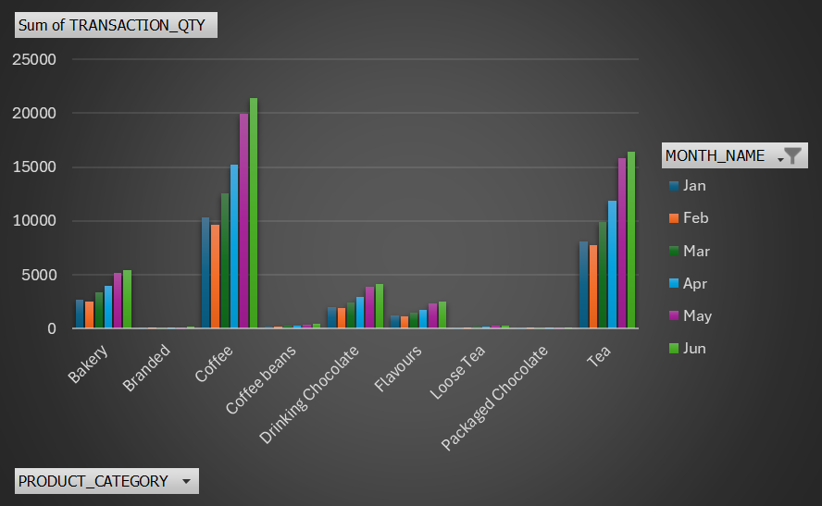
Product category sales per day
Product category sale per month
Insights:
Coffee contributes 39,17% of number sales
Tea with 30,48%
While branded, loose tea and packaged chocolate with the lowest number sale with 0,50%,0,81% and 0,33% each.

Slide 6
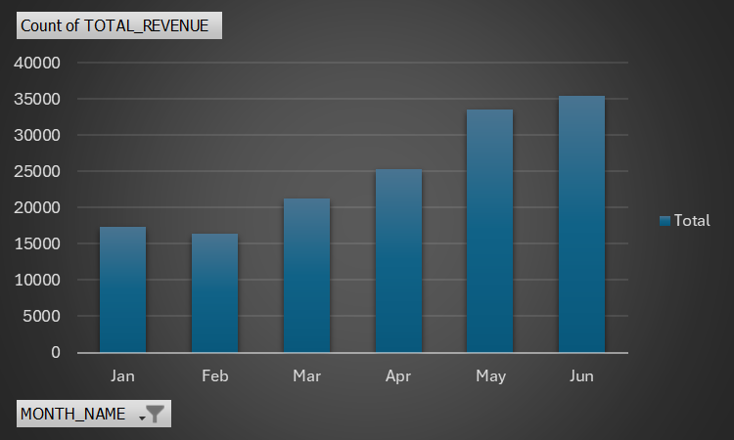
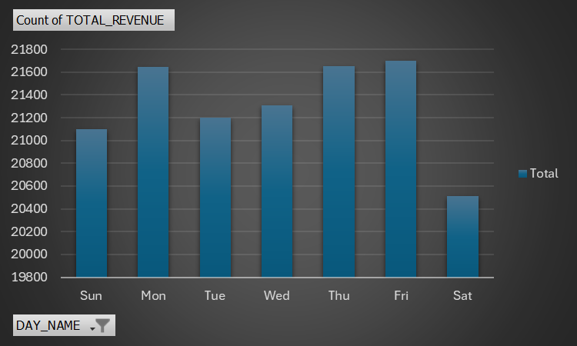
Total revenue per month
Total revenue per day
Insight:
June and May contributes the highest revenue
with 23,71% and 22,48%
While Jan and Feb have the lowest revenue with
11,61% and 10,97%
Insight:
Sat 13,75% with the lowest revenue
While the other days average 14% revenue

Slide 7
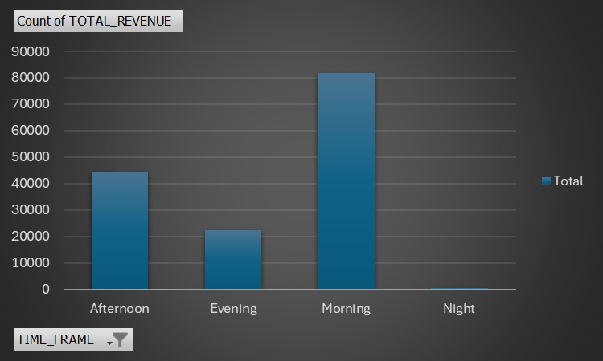
Sales per Timeframe
Insights:
Afternoon contributes 29,79% of the total revenue
While evening is 14,99%
The morning contribute the highest revenue with 54,82%
And night is lowest with 0,39%

Slide 8
Conclusion
Optimize store performance by location
Focus on improving sales in Lower Manhattan during peak hours to match the performance of Hell's Kitchen and Astoria
Create target strategies for Astoria to maximise afternoon and evening sales, given its strong performance during these times
Boost sales of underperforming products
Evaluate and potentially phase out low-performing products categories (branded items, loose tea, packaged chocolate) or introduce promotions to increase their sales.
Capitalize on high-demand categories like coffee and tea by expanding offerings or improving marketings efforts
Increase revenue during low performing periods
Implement strategies such as discounts or special promotions during evenings and on Saturdays to attract more customers
Explore ways to drive nighttime sales, which contribute the least revenue (0,39%).

